Slide 1

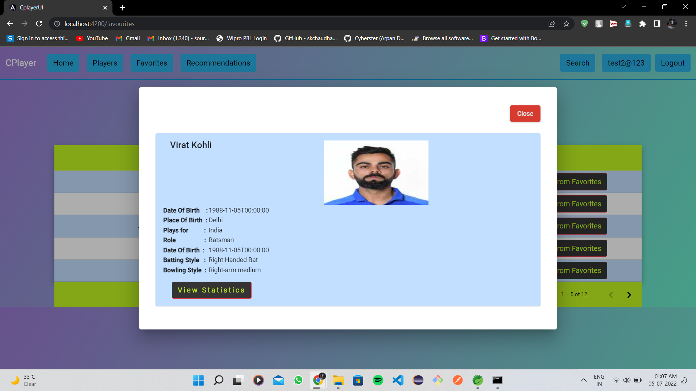

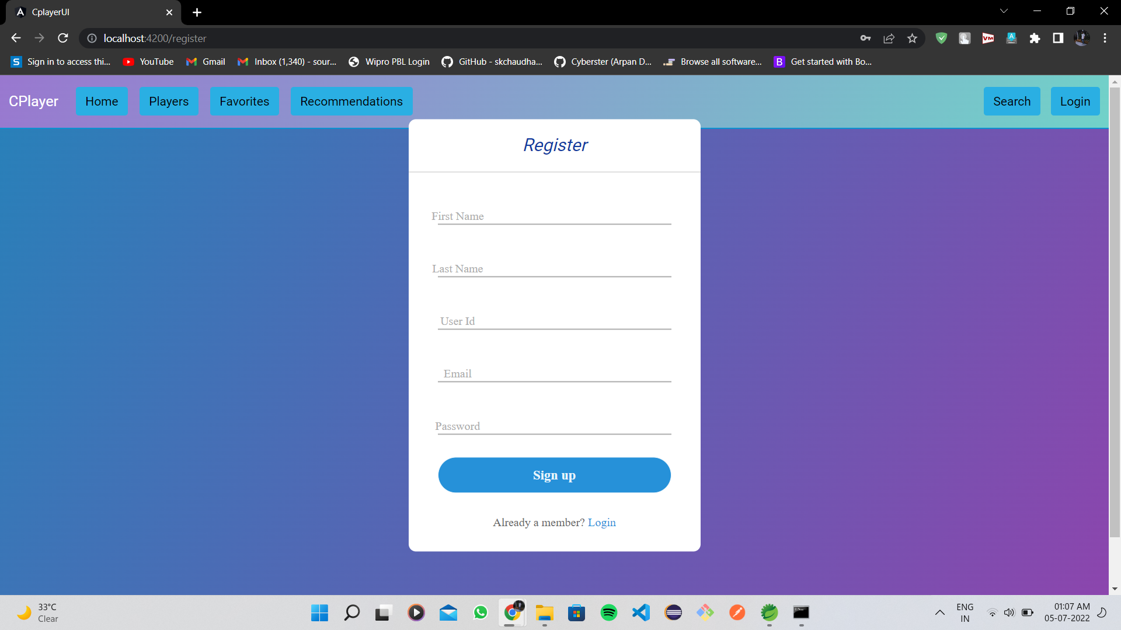
C-Player App
Batch: 47 & Team: 2
Presented By: SOURABH SIKKA
SHIVASUPRITH BEJUGAM
CHOUDAM JAYA SANKAR
Presented to: Mr. N. Ravi Chandra

Slide 2
Outline
Problem Statement
Objective
Microservices
Project Overview
Architecture
Application Flow
Technology and Tools Used
Conclusion

Slide 3

Problem Statement
A person likes cricket a lot and for that kind of person CPlayer Application is perfect. For viewing statistics of favorite player and for any recommendations. Even for searching about the players which he/she don’t know, some app must be there.

Slide 4
Objective
Our objective is to provide best user experience to every person so that he/she can have the information about their favourite players at one place and able to access the information from anywhere on the go.

Slide 5
Microservices
Recommendation API
Favourite API
(favouriteservice)
Authentication API
(userservice)

Slide 6
Project Overview

Slide 7
Project Overview
Authentication API
Favourite API
Recommendation API
Favourite
Login
Recommendation
Home
Register
Search
SQL
Server
Mongo
Db
Mongo
Db
External API

Slide 8
Onboarding Architecture

Slide 9
Architecture
Authentication API
JWT validator
SQL Server
Login/Register
POST request
Token generated
Favourite API
Get favourite
Delete favourite
POST /GET/
DELETE
Mongo Db
GET/DELETE
Front End
Angular
GET
Recommendation API
Get Recommends
Mongo Db
GET
Search Player
Get Statistics
External API
GET
GET

Slide 10
Project Flow

Slide 11
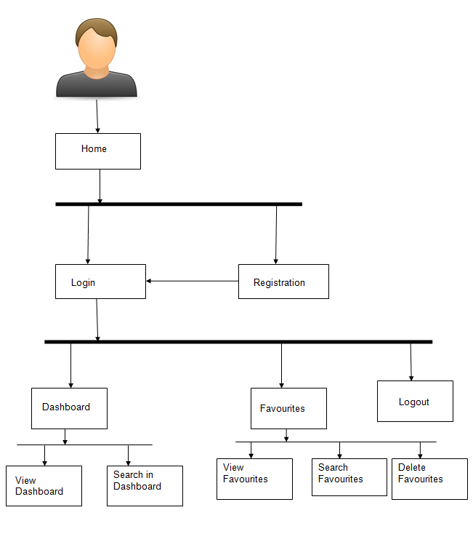
Project Flow
Home
Login
Register
Search
Add to Favourite
Favourite
Recommends
Recommendations
View Favourites
Delete Favourite
View Recommends
Add to Favourite
Search Books

Slide 12








Technologies and Tools Used

Slide 13
Conclusion
The C Player app helps the user to get the statistics of the players online. It also helps user to store the favourite players, get recommendations and delete them afterwards.

Slide 14
Thank You

Slide 15


